Slide 1
‘the New Colossus’
By Emma Lazarus

Slide 2
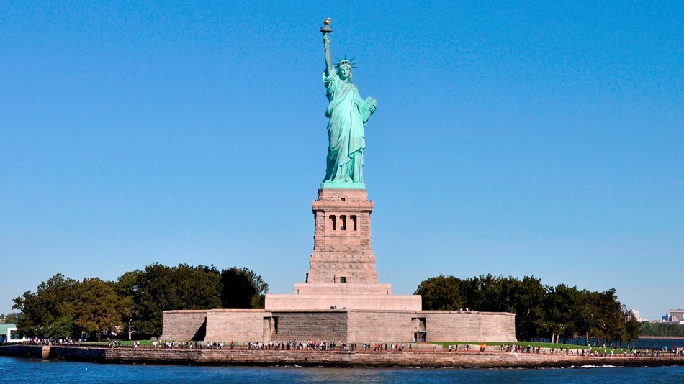
Warm Up
The Declaration of Independence states:
“We hold these truths to be self-evident, that all men are created equal, that they are endowed by their Creator with certain inalienable rights, that among these are life, liberty, and the pursuit of happiness.”
What does Liberty mean?
Why do you think liberty would be considered a basic right?

Slide 3
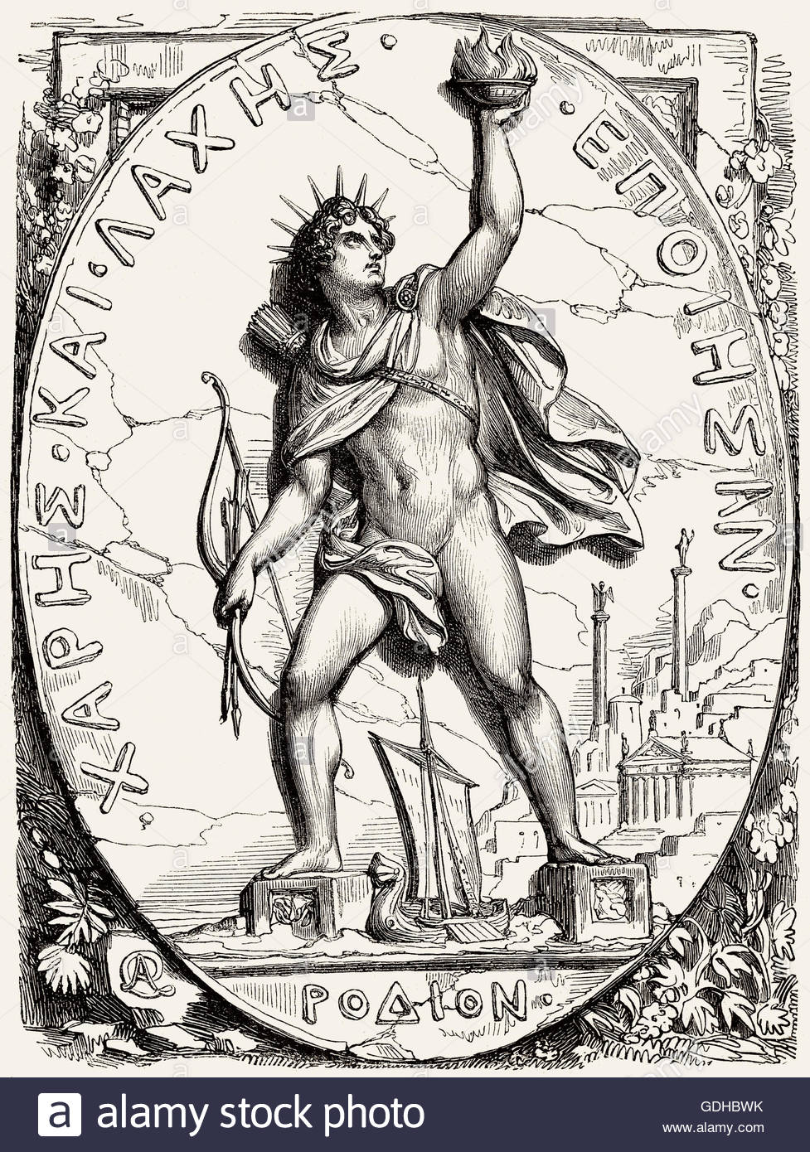
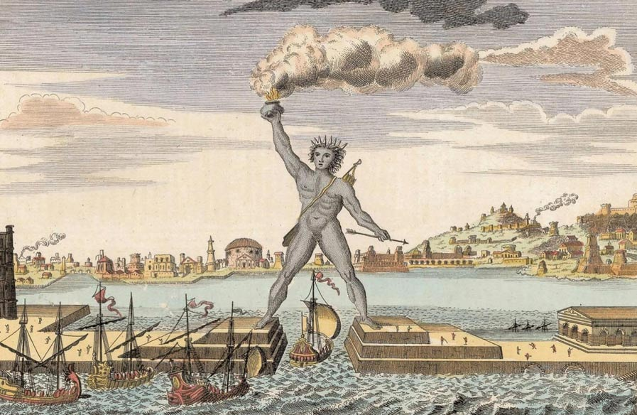

Slide 4
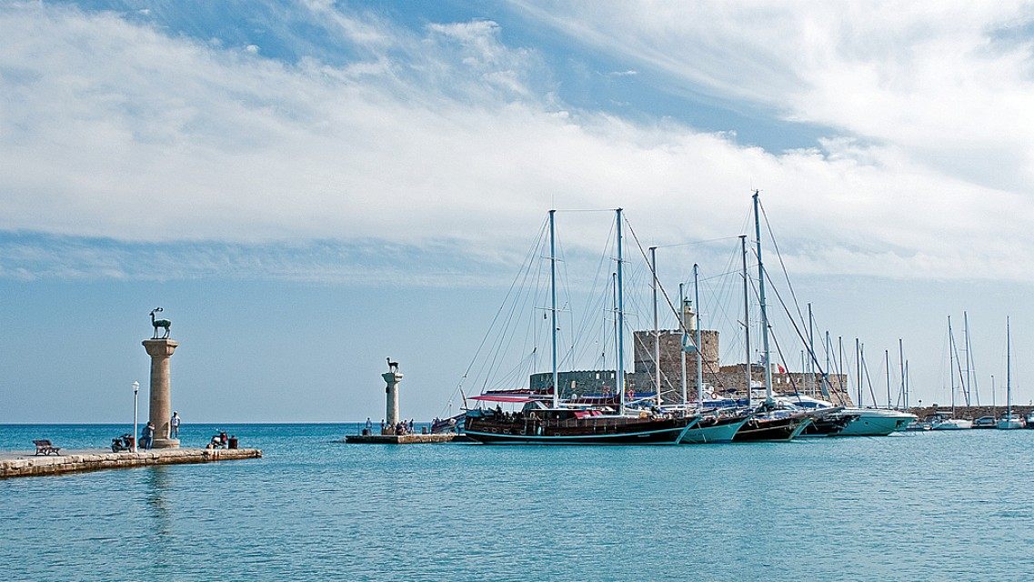

Slide 5
1. Read Poem Vocabulary Exiles- a person who lives away from their native country, either from choice or compulsion. Pomp- ceremony and splendid display, especially at a public event. Yearning- a feeling of intense longing for something. Wretched- in a very unhappy or unfortunate state. 2. Colossus OG 3. Re-read the poem and mark words that you think have a positive connotation with a P and words with a negative connotation with an N.

Slide 6
Write an informational essay explaining both statues and the connection of Emma Lazarus’ poem
Colossus of Rhodes | The Statue of Liberty

Slide 7
Outline
Paragraph 1
Explain Colossus History
Paragraph 2
Explain Statue of Liberty History
Paragraph 3
Connect Lazarus Poem to both

Slide 8
Sources: https://www.vice.com/en_us/article/mvkgjb/the-statue-of-liberty-was-originally-intended-to-celebrate-the-end-of-american-slavery https://www.ducksters.com/history/us_1800s/statue_of_liberty.php https://www.awesomestories.com/asset/view/Colossus-of-Rhodes (contains video) https://kids.kiddle.co/Emma_Lazarus Anything different here than in other articles?

Slide 9
Paper Requirements
Minimum 3 paragraphs
Clear Topic and Conclusion sentences
Must clearly show relationship between The Colossus of Rhodes, The Statue of Liberty, and Emma Lazarus’s poem, ‘The New Colossus.’
Proper spelling, varied sentence structure, apply grammar rules
Due Tuesday-venn diagram, planner, and final copy (printed)

